Slide 1

Intel Concurrent Collections (for Haskell)
Ryan Newton*, Chih-Ping Chen*, Simon Marlow+
*Intel
+Microsoft Research
Software and Services Group
Jul 29, 2010

Slide 2


Goals
Streaming/Actors/
Dataflow
Push Parallel Scaling in Haskell
Never trivial
Harder with: Laziness, complex runtime
Offer another flavor of parallelism:
Explicit graph based
C
n
C
a `par` b
forkIO$ do…
Pure operand parallelism
Threaded parallelism
Data Parallelism
[: x*y | x<-xs | y<-ys :]

Slide 3
Intel Concurrent Collections (CnC)
These models: A bit more domain specific (than, say, futures)
A payoff in parallelism achieved / effort
CnC is approximately:
stream processing + shared data structures
Intel CnC: A library for C++
Also for Java, .NET thanks to Rice U. (Vivek Sarkar et al)
Yet… CnC requires and rewards pure functions -- Haskell is a natural fit.
Streaming/Actors/
Dataflow
C
n
C

Slide 4

Haskell / CnC Synergies
 | C++ incarnation | Haskell incarnation
CnC Step | hopefully pure execute method | Pure function Enforce step purity.
Complete CnC Graph Execution | Graph execution concurrently on other threads. Blocking calls allow environment to collect results. | Pure function. Leverage the fact that CnC can play nicely in a pure framework.
Also, Haskell CnC is a fun experiment.
We can try things like idempotent work stealing!
Most imperative threading packages don’t support that.
Can we learn things to bring back to other CnC’s?

Slide 5
How is CnC called from Haskell?
Haskell is LAZY
To control par. eval granularity Haskell CnC is mostly eager.
When the result of a CnC graph is needed, the whole graph executes, in parallel, to completion.
(e.g. WHNF = whole graph evaluated)
Fork workers
Par exec.
Need result!
Recv.
result

Slide 6
A complete CnC program in Haskell
myStep items tag = do word1 <- get items "left" word2 <- get items "right" put items "result" (word1 ++ word2 ++ show tag) cncGraph = do tags <- newTagCol items <- newItemCol prescribe tags (myStep items) initialize$ do put items "left" "Hello " put items "right" "World " putt tags 99 finalize$ do get items "result" main = putStrLn (runGraph cncGraph)

Slide 7
Initial Results

Slide 8
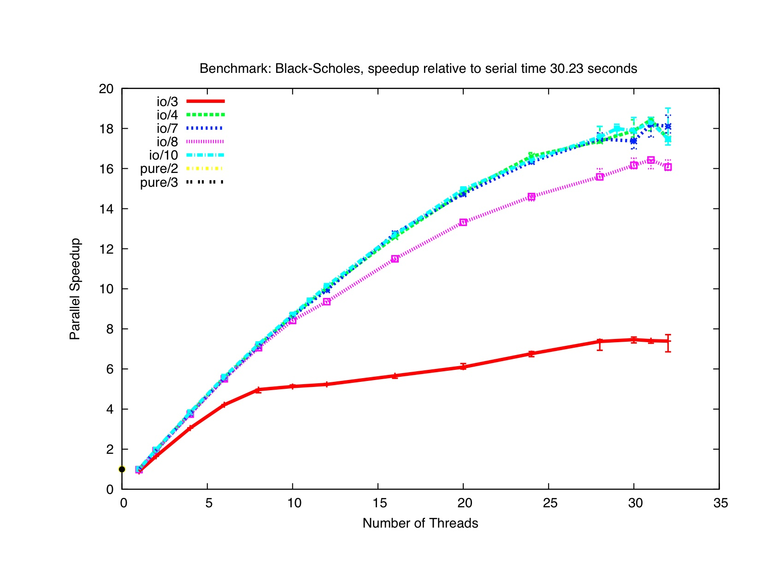
I will show you graphs like this:
(4 socket 8 core Westmere)

Slide 9
Current Implementations
Thread per step instance.
IO based + pure impl.s
Lots of fun with schedulers!
Lightweight user threads (3)
Data.Map of MVars for data.
Global work queue (4,5,6,7,10)
Continuations + Work stealing (10,11)
Simple Data.Sequence deques
Haskell “spark” work stealing (8,9)
(Mechanism used by ‘par’)
Cilkish sync/join on top of IO threads
Step(0)
Step(1)
Step(2)
…
thr1
thr2
thr3
wrkr1
wrkr2
wrkr3
Global work pool
wrkr1
wrkr2
Per-thread work deques

Slide 10
Back to graphs…

Slide 11


Slide 12
声明：
所有的版权属于原有公司，文件均来自公开渠道
此文件仅供学习使用，任何人不得进行以此为商业目的的行为
如有疑问，请立即删除
学习世界五百强和咨询公司PPT课程请访问如下网站搜索：“司马懿”
百度传课：司马懿PPT学校
https://www.chuanke.com
网易学堂：司马懿PPT学校
https://study.163.com
知乎： 司马懿PPT学校
https://www.zhiu.com

